Slide 1
Chapter 3
Classification
MNIST
Training a Binary Classifier
Performance Measures
Measuring Accuracy Using Cross-Validation
Confusion Matrix
Precision and Recall
Precision/Recall Trade-off
The ROC Curve
Multiclass Classification
Error Analysis
Multilabel Classification
Multioutput Classification

Slide 2
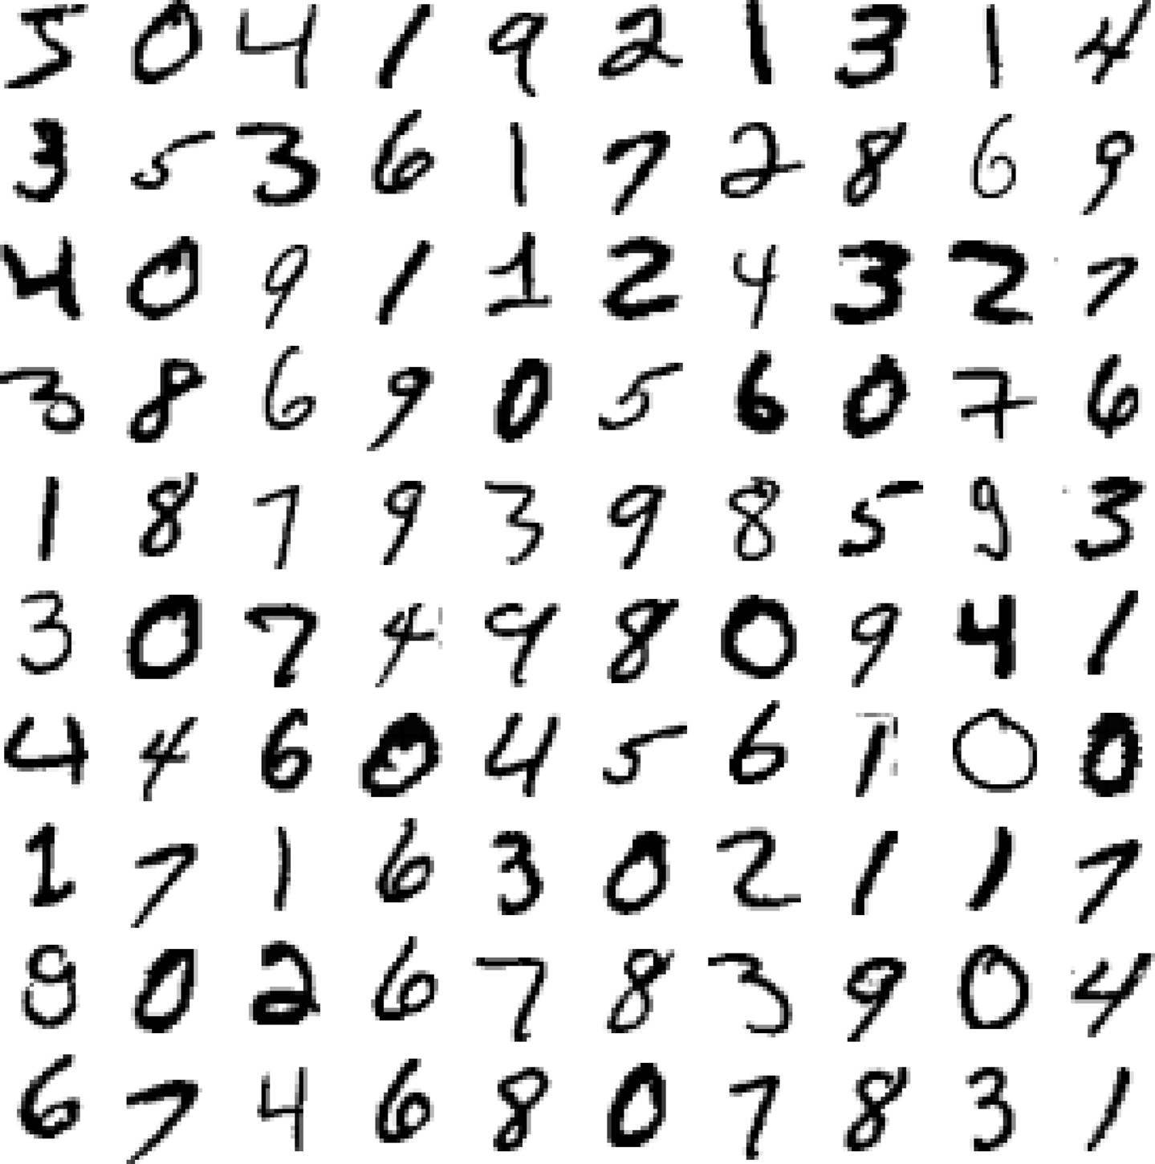
Notes:
In this chapter we will be using the MNIST dataset, which is a set of 70,000 small images of digits handwritten by high school students and employees of the US Census Bureau. Each image is labeled with the digit it represents. This set has been studied so much that it is often called the “hello world” of Machine Learning: whenever people come up with a new classification algorithm they are curious to see how it will perform on MNIST, and anyone who learns Machine Learning tackles this dataset sooner or later.
There are 70,000 images, and each image has 784 features. This is because each image is 28 × 28 pixels, and each feature simply represents one pixel’s intensity, from 0 (white) to 255 (black).

Slide 3
Training a Binary Classifier
Let’s simplify the problem for now and only try to identify one digit—for example, the number 5. This “5-detector” will be an example of a binary classifier, capable of distinguishing between just two classes, 5 and not-5

Slide 4
Performance Measures
Measuring Accuracy Using Cross-Validation
Confusion Matrix
Precision and Recall also called sensitivity or the true positive rate (TPR)
Precision/Recall Trade-off
The ROC Curve receiver operating characteristic

Slide 5
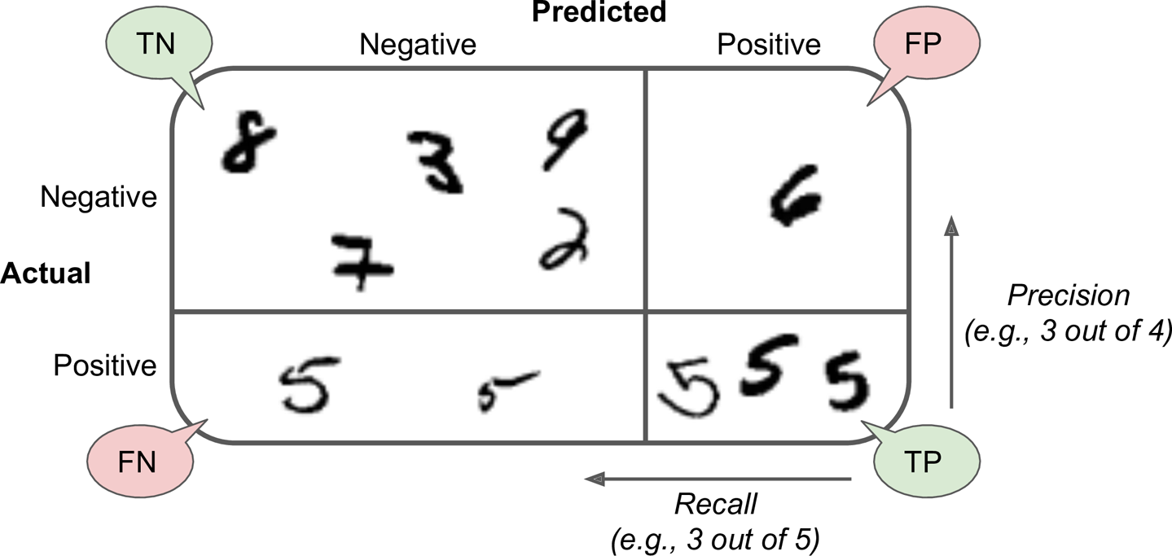

Slide 6
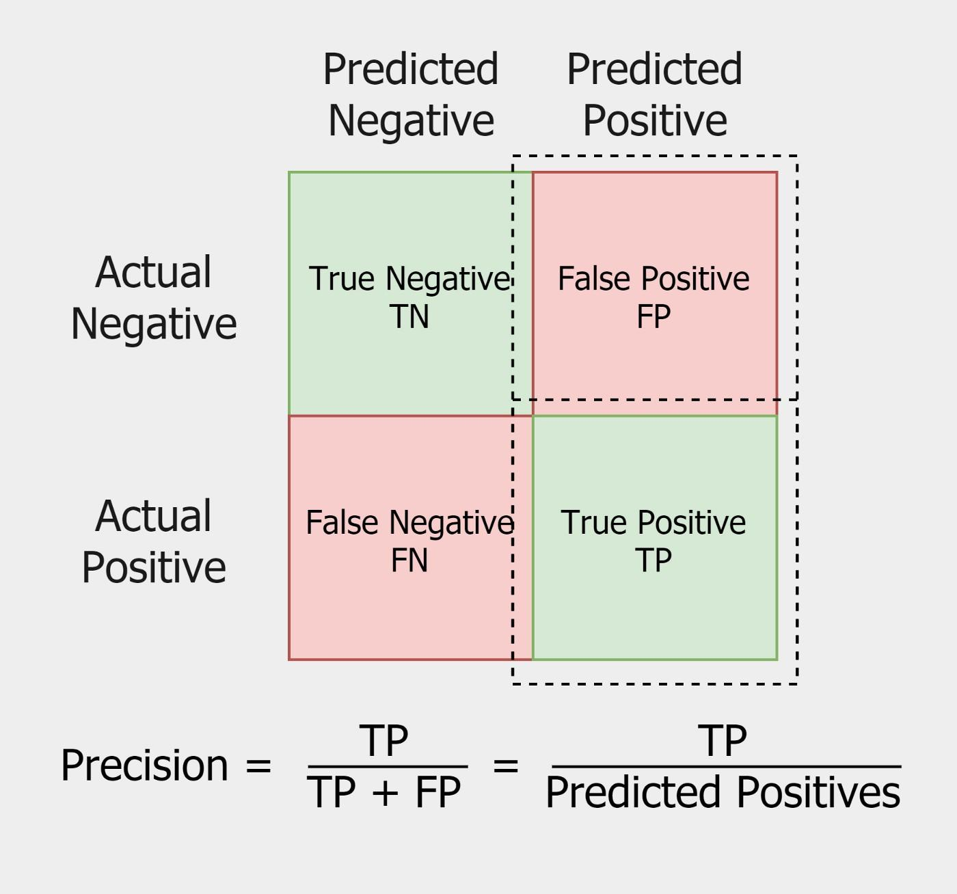

Slide 7
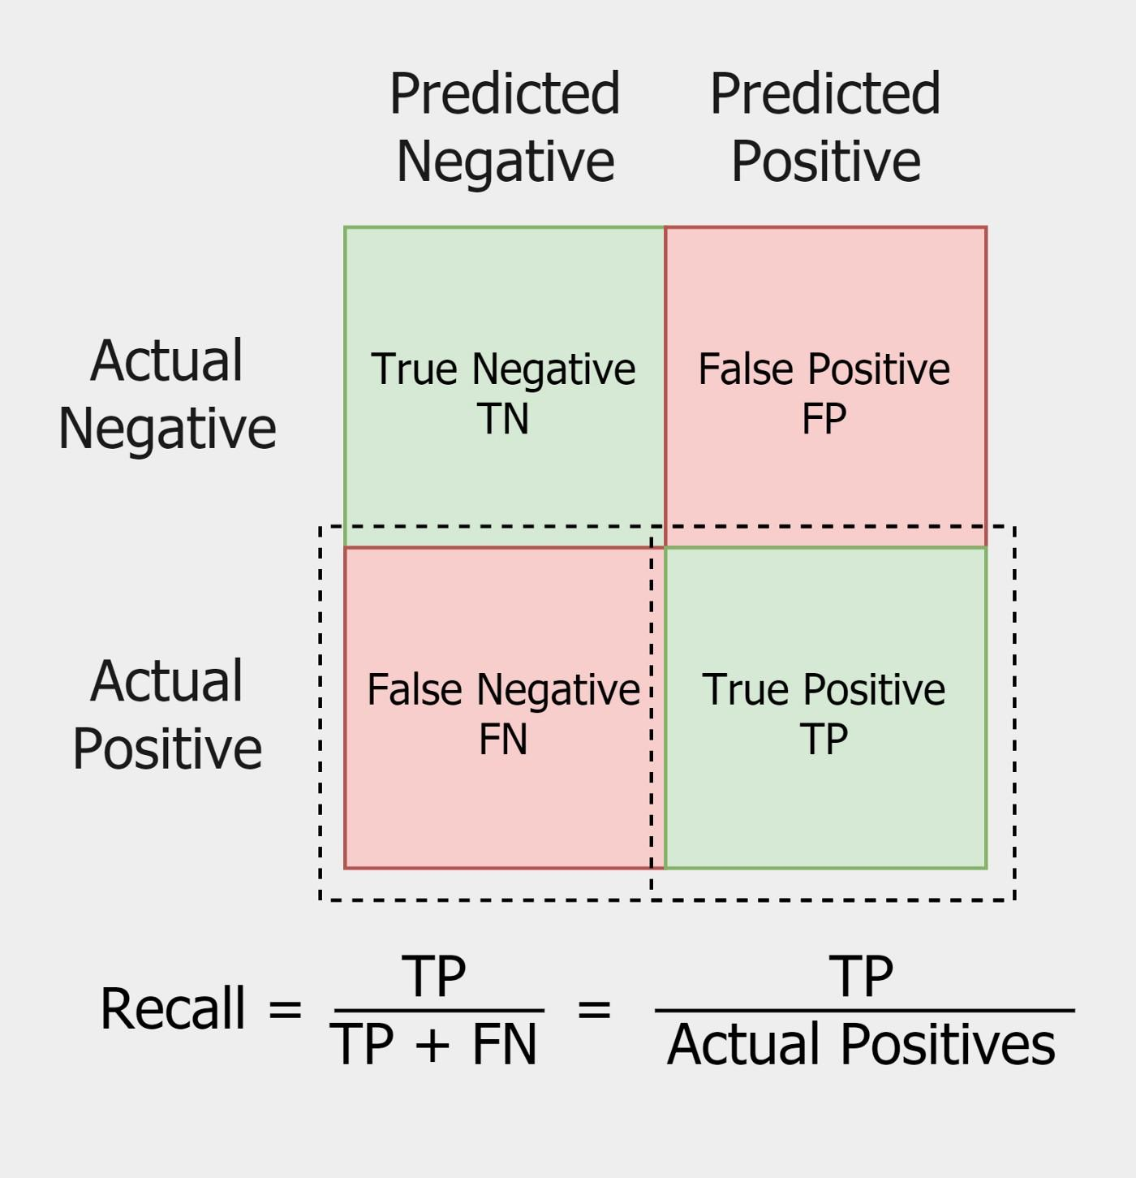

Slide 8
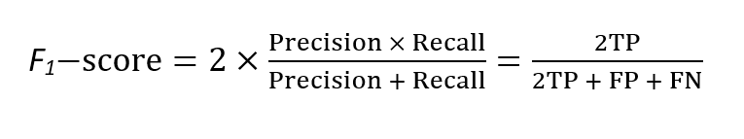

Slide 9
The cancer case
We have 100 people, 12 of them have cancer, the model diagnoses 9 with cancer, 5 of them were right.
TP ⇒ 5
TN ⇒ 84
FP ⇒ 4
FN ⇒ 7
Precision ⇒ 5/9
Recall ⇒ 5/12
—--
—--
—--
—--
—-----
—-----

Slide 10
RECALL
??
Precision
Notes:
The F1 score favors classifiers that have similar precision and recall. This is not always what you want: in some contexts you mostly care about precision, and in other contexts you really care about recall.
For example, if you trained a classifier to detect videos that are safe for kids, you would probably prefer a classifier that rejects many good videos (low recall) but keeps only safe ones (high precision), rather than a classifier that has a much higher recall but lets a few really bad videos show up in your product (in such cases, you may even want to add a human pipeline to check the classifier’s video selection).
On the other hand, suppose you train a classifier to detect shoplifters in surveillance images: it is probably fine if your classifier has only 30% precision as long as it has 99% recall (sure, the security guards will get a few false alerts, but almost all shoplifters will get caught).

Slide 11
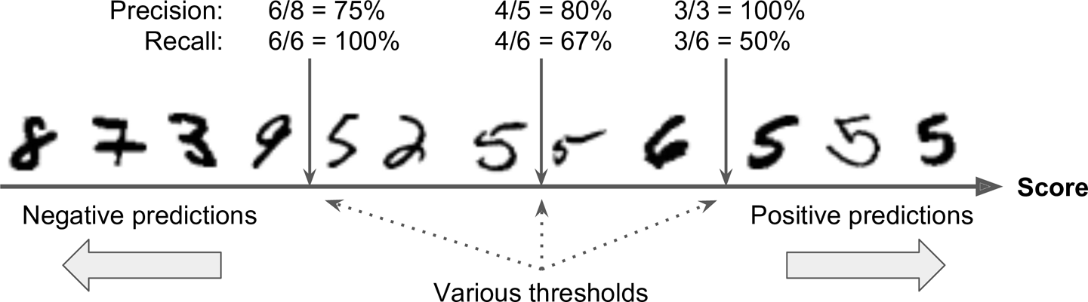
Precision/Recall Trade-off
Notes:
To understand this trade-off, let’s look at how the SGDClassifier makes its classification decisions. For each instance, it computes a score based on a decision function. If that score is greater than a threshold, it assigns the instance to the positive class; otherwise it assigns it to the negative class.
The figure shows a few digits positioned from the lowest score on the left to the highest score on the right. Suppose the decision threshold is positioned at the central arrow (between the two 5s): you will find 4 true positives (actual 5s) on the right of that threshold, and 1 false positive (actually a 6). Therefore, with that threshold, the precision is 80% (4 out of 5). But out of 6 actual 5s, the classifier only detects 4, so the recall is 67% (4 out of 6). If you raise the threshold (move it to the arrow on the right), the false positive (the 6) becomes a true negative, thereby increasing the precision (up to 100% in this case), but one true positive becomes a false negative, decreasing recall down to 50%. Conversely, lowering the threshold increases recall and reduces precision.

Slide 12
ROC Curve
The receiver operating characteristic (ROC) curve is another common tool used with binary classifiers. It is very similar to the precision/recall curve, but instead of plotting precision versus recall, the ROC curve plots the true positive rate (another name for recall) against the false positive rate (FPR). It is equal to 1 – the true negative rate (TNR). The TNR is also called specificity.
Hence, the ROC curve plots sensitivity (recall) versus 1 – specificity.

Slide 13
So what should I use?
Since the ROC curve is so similar to the precision/recall (PR) curve, you may wonder how to decide which one to use. As a rule of thumb, you should prefer the PR curve whenever the positive class is rare or when you care more about the false positives than the false negatives. Otherwise, use the ROC curve. For example, looking at the previous ROC curve (and the ROC AUC score), you may think that the classifier is really good. But this is mostly because there are few positives (5s) compared to the negatives (non-5s). In contrast, the PR curve makes it clear that the classifier has room for improvement (the curve could be closer to the top-left corner).

Slide 14
You now know how to train binary classifiers, choose the appropriate metric for your task, evaluate your classifiers using cross-validation, select the precision/recall trade-off that fits your needs, and use ROC curves and ROC AUC scores to compare various models. Now let’s try to detect more than just the 5s.

Slide 15
multiclass classifiers
multiclass classifiers (also called multinomial classifiers) can distinguish between more than two classes.
Some algorithms are capable of handling multiple classes directly like :
Random Forest classifiers
naive Bayes classifiers
Some algorithms are strictly binary classifiers like:
Support Vector Machine classifiers (SVM)
Linear classifiers

Slide 16
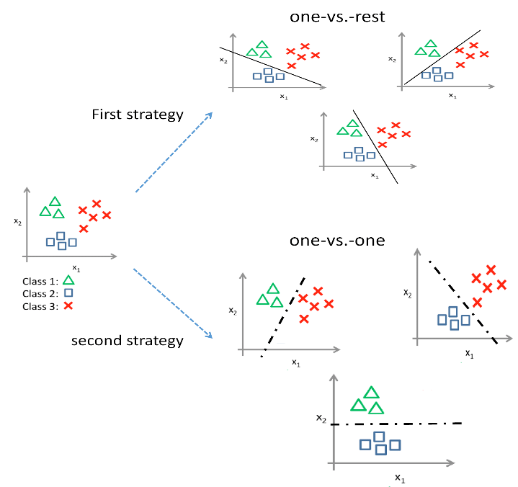
Multiclass Classification
OvR
OvO
Notes:
Some algorithms (such as SGD classifiers, Random Forest classifiers, and naive Bayes classifiers) are capable of handling multiple classes natively. Others (such as Logistic Regression or Support Vector Machine classifiers) are strictly binary classifiers. However, there are various strategies that you can use to perform multiclass classification with multiple binary classifiers.
One way to create a system that can classify the digit images into 10 classes (from 0 to 9) is to train 10 binary classifiers, one for each digit (a 0-detector, a 1-detector, a 2-detector, and so on). Then when you want to classify an image, you get the decision score from each classifier for that image and you select the class whose classifier outputs the highest score. This is called the one-versus-the-rest (OvR) strategy (also called one-versus-all).
Another strategy is to train a binary classifier for every pair of digits: one to distinguish 0s and 1s, another to distinguish 0s and 2s, another for 1s and 2s, and so on. This is called the one-versus-one (OvO) strategy. If there are N classes, you need to train N × (N – 1) / 2 classifiers. For the MNIST problem, this means training 45 binary classifiers! When you want to classify an image, you have to run the image through all 45 classifiers and see which class wins the most duels. The main advantage of OvO is that each classifier only needs to be trained on the part of the training set for the two classes that it must distinguish.
Some algorithms (such as Support Vector Machine classifiers) scale poorly with the size of the training set. For these algorithms OvO is preferred because it is faster to train many classifiers on small training sets than to train few classifiers on large training sets. For most binary classification algorithms, however, OvR is preferred.
Scikit-Learn detects when you try to use a binary classification algorithm for a multiclass classification task, and it automatically runs OvR or OvO, depending on the algorithm.

Slide 17
OvO example
consider a multi-class classification problem with four classes: ‘red,’ ‘blue,’ and ‘green,’ ‘yellow.’ This could be divided into six binary classification datasets as follows:
Binary Classification Problem 1: red vs. blue
Binary Classification Problem 2: red vs. green
Binary Classification Problem 3: red vs. yellow
Binary Classification Problem 4: blue vs. green
Binary Classification Problem 5: blue vs. yellow
Binary Classification Problem 6: green vs. yellow

Slide 18
Error Analysis
If this were a real project, you would now follow the steps in your Machine Learning project checklist. You’d explore data preparation options, try out multiple models (shortlisting the best ones and fine-tuning their hyperparameters using GridSearchCV), and automate as much as possible. Here, we will assume that you have found a promising model and you want to find ways to improve it. One way to do this is to analyze the types of errors it makes.

Slide 19
Multilabel Classification
&
Multioutput Classification
What is the difference between Multilabel, Multiclass and Multioutput?

Slide 20
Questions?

